Slide 1
Part 7: Memory Organization
Bind Code and Data to Memory
address binding, logical versus physical address space
Contiguous Allocation
fixed vs. dynamic partitioning, fragmentation
Paging
address translation, page table implementation, shared pages, two-level page-table, inverted page table
Segmentation
address translation
Notes:
Effective memory management is vital in a multiprogramming system. To improve CPU utilization, multiple processes need to be loaded into memory to ensure a reasonable supply of ready processes to consume available CPU time.
We begin this chapter by understanding how a process gets executed. Next, we approach the technology of memory management by looking at a variety of schemes that have been used.

Slide 2
Bind Code and Data to Memory
To run a program, a process image must be created and loaded into memory
low address
text
(code section, program)
data
(global parameters)
heap
(dynamically allocated variables,
e.g., a=new int[10])
stack
(parameters and local variables
in a function)
high address
Notes:
How is memory allocated for a process image?
Logical view of a process in memory (also called process image) – not just code and data, but also include dynamic memory space (stack and heap) required during process execution
It defines logically the space a process is able to access (or address) during its execution. So, this is called logical address space of a process. Address reference generated when executing an instruction always refers to this logical address space and is called logical address.

Slide 3
Binding of Code and Data to Memory (Cont.)
Source
code
Compiler: Translate source code to object code
Linker: Combine object modules to resolve references
Loader: - Create process image
- Allocate memory
- Load process image to the allocated memory
Compiler
Library
code
Loader
Process
Image
Object
Module
Linker
Load
Module
Disk
Memory
Notes:
How is a process image generated and loaded?
Loader is part of OS
A program may contain multiple source code files. Source code files are compiled into object files. The linker combines these object files into a single binary executable (i.e., the load module on disk). During the linking phase, other object files or libraries may be included as well, such as the standard C or math library. A loader is used to load the binary executable file into memory where its is eligible to run on a CPU core.

Slide 4
Binding of Code and Data to Memory (Cont.)
.
.
Instruction needs to be fetched from memory
LOAD X
LOAD X
.
.
CPU
JUMP Y
Execute an instruction may again require to access memory
Can address X be used to load data?
.
.
Memory
Notes:
As a process executes, it accesses instructions and data in memory.
CPU must deal with memory references generated. Branch instructions contain an address to reference the instruction to be executed next. Data reference instructions contain the address of the byte or word of data referenced.
Address generated while executing an instruction may not be used directly to access physical memory, depending on when address binding is performed.

Slide 5
Binding of Code and Data to Memory (Cont.)
Address binding of instructions and data to memory addresses can happen at three different stages.
Compile time: If memory location known a priori, absolute code can be generated; must recompile code if starting location changes.
Load time: Compiler generates relocatable code. Binding is performed by the loader.
Execution time: If the process can be moved during its execution from one memory segment to another, binding is delayed until run time.
Notes:
Address binding refers to the action of binding (or translating) the addresses in process image to the physical memory addresses (or absolute addresses).

Slide 6
Binding of Code and Data to Memory (Cont.)
Absolute
Address
1024
1024
.
.
.
.
LOAD 1824
LOAD 1824
LOAD 1824
LOAD 1824
Loader
1424
.
.
1424
.
.
JUMP 1424
JUMP 1424
.
.
.
.
1824
1824
.
.
.
.
Memory
Compile Time Binding

Slide 7
Binding of Code and Data to Memory (Cont.)
Relocatable
Address
0
1024
.
.
.
.
LOAD 1824
LOAD 1824
LOAD 800
LOAD 1824
Loader
400
.
.
1424
.
.
JUMP 400
JUMP 1424
.
.
.
.
800
1824
.
.
.
.
Memory
Load Time Binding
Notes:
Compiler generates code in re-locatable address format, i.e.,
address format that is relative to the beginning of the address space (also called relative address).
Loader will translate the re-locatable address to absolute address.

Slide 8
Binding of Code and Data to Memory (Cont.)
Relocatable
Address
base
0
1024
.
.
.
.
LOAD 1824
LOAD 1824
LOAD 800
LOAD 800
Loader
400
.
.
1424
.
.
limit
JUMP 400
JUMP 400
.
.
.
.
800
1824
.
.
.
.
2024
Memory
Execution Time Binding
Notes:
Base – starting address where process image is loaded in the memory.
Limit – size of the memory space occupied by the process.

Slide 9
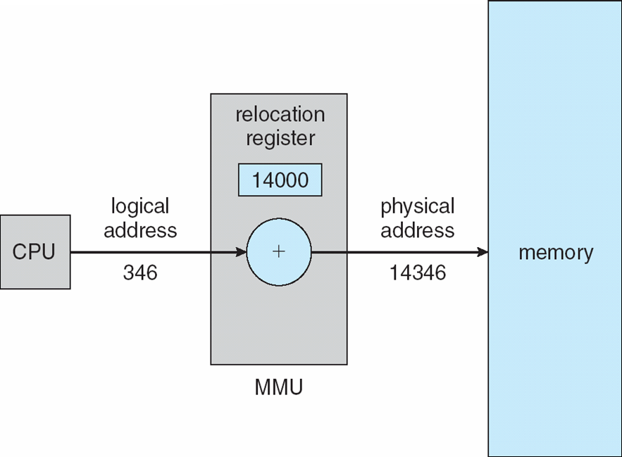
Binding of Code and Data to Memory (Cont.)
1024
800
1824
Execution Time Binding

Slide 10
Binding of Code and Data to Memory (Cont.)
In compile- or load-time binding, absolute address format is used in process image
base
1024
.
.
fetch an instruction
LOAD 1824
LOAD 1824
1424
.
.
load
data
CPU
JUMP 1424
.
.
If address generated by CPU < base OR ≥ base + limit ⇒ error
Otherwise, memory address = address generated by CPU
1824
.
.
base+limit
2024
Memory
Notes:
For compile-time and load-time binding, absolute address is used directly to access memory.
So, the binding of logical address space to the physical memory is static. Once process image is loaded, it can’t be moved in the memory.
In a multiprogramming system, the available memory is generally shared among a number of processes. Typically, it is not possible for the programmer to know in advance which other programs will be resident in physical memory at the time of execution of his or her program. In addition, we would like to be able to:
Perform memory compaction
Swap in and out process
Provide virtual memory support
Hence, we are not interested in compile- or load-time binding.

Slide 11
Binding of Code and Data to Memory (Cont.)
In execution-time binding, relative address format is used in process image
base
1024
.
.
fetch an instruction
LOAD 800
LOAD 800
1424
.
.
load
data
CPU
JUMP 400
.
.
If address generated by CPU ≥ limit ⇒ error
Otherwise, memory address = address generated by CPU + base
800+1024 =
1824
.
.
base+limit
2024
Memory
Notes:
Relative address – address format that is relative to the beginning of the process image.
Base – starting address where process image is loaded in the memory.
In execution-time binding, address generated by CPU needs to be translated to the one used to access memory and this translation depends on memory allocation method used.
The address translation is done by MMU and supported by hardware – recall base and limit registers.
Execution-time binding is dynamic, process image can be moved in the memory. In the following lecture, we assume execution-time binding.

Slide 12
Logical vs. Physical Address Space
Address Space – all addresses accessible by a process
Logical address – address used in the code, generated by the CPU when executing an instruction.
Physical address – address used to access physical memory, seen by the memory unit.
Notes:
Process executes in logical address space and it never sees physical address. There is one logical address space per process.
To access physical memory, logical address may need to be translated into physical address.

Slide 13
Logical vs. Physical Address Space
Logical address space can be viewed as a linear, or one-dimensional, continuous address space consisting of a sequence of bytes
For execution time binding, logical address space always starts from 0.
0
1
.
.
.
Process Image /
Logical Address Space /
Logical Memory
Limit
i
.
.
.
Limit-1

Slide 14
How to Allocate Memory among Processes
Two approaches:
Contiguous Allocation
The logical address space of a process remains contiguous in physical memory
Fixed Partitioning
Dynamic Partitioning
Non-contiguous Allocation
A process logical address space is scattered over different regions in physical memory

Slide 15
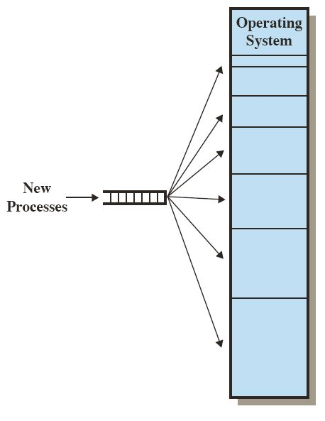
Contiguous Allocation
Fixed Partitioning
Memory is partitioned into regions with fixed boundaries
Notes:
• The number of partitions specified at system generation time limits the number of active processes in the system.
• Because partition sizes are preset at system generation time, small processes will not utilize partition space efficiently. Any process, no matter how small, occupies an entire partition. This approach is not really practical. It is difficulty to determine the number of partitions and size of each partition since the memory requirements of all processes are in general unknown beforehand.

Slide 16
Contiguous Allocation (Cont.)
Dynamic Partitioning
Hole – block of available memory; holes of various size are scattered throughout memory.
When a process arrives, it is allocated memory from a hole large enough to accommodate it.
Operating system maintains information about
allocated partitions
free partitions (hole)
Notes:
Initially, there is a single hole.
Memory allocation status may change while processes are created (allocate memory) and terminate (de-allocate memory).
Eventually, as time goes, memory contains a list of holes of vary size.

Slide 17
Contiguous Allocation (Cont.)
0
Operating system
Job queue
400K
process
memory
time
P1
P2
P3
P4
P5
600K
1000K
300K
700K
500K
10
5
20
8
15
2160K
2560K

Slide 18
Contiguous Allocation (Cont.)
0
Operating system
Operating system
Operating system
Operating system
Operating system
400K
P1
P1
P1
P1
P5
Job queue
process
memory
time
1000K
P4
P4
P4
P1
P2
P3
P4
P5
600K
1000K
300K
700K
500K
10
5
20
8
15
P2
300K
2000K
P3
P3
P3
P3
P3
2300K
260K
2560K
time
0
5
10
Notes:
With dynamic partitioning, the partitions are of variable length and number. When a process is brought into physical memory, it is allocated exactly as much memory as it requires and no more.

Slide 19
Dynamic Storage-Allocation Problem
How to satisfy a request of size n from a list of free holes.
First-fit: Allocate the first hole that is big enough.
Best-fit: Allocate the smallest hole that is big enough; must search entire list, unless ordered by size. Produces the smallest leftover hole.
Worst-fit: Allocate the largest hole; must also search entire list. Produces the largest leftover hole.
Notes:
Given memory requirement of a process, dynamic storage allocation policies determine which one to use amongst a list of free holes.

Slide 20
Fragmentation
External fragmentation: when enough total memory space exists to satisfy a request, but it is not contiguous. Happens outside a partition.
Internal fragmentation: allocated memory may be slightly larger than requested memory; this size difference is memory internal to a partition, but not being used.
Notes:
Variable partitioning -> external fragmentation
Fixed partitioning -> internal fragmentation

Slide 21
Fragmentation (Cont.)
Reduce external fragmentation by compaction
Shuffle memory contents to place free memory together in one large block.
Compaction is possible only if re-locatable address format is used in process image and binding is done during execution-time.
Notes:
From time to time, the OS shifts the processes so that all of the free memory is together in one block. The difficulty with compaction is that it is a time-consuming procedure and wasteful of processor time. Note that compaction implies the need for a dynamic relocation capability. That is, it must be possible to move a process from one region to another in memory without invalidating the memory references in the program.

Slide 22
Fragmentation (Cont.)
0
Operating system
Operating system
Operating system
Operating system
Operating system
400K
P1
P1
P1
P1
P1
Job queue
process
memory
time
1000K
P4
P4
P4
P1
P2
P3
P4
P5
600K
1000K
300K
700K
500K
10
5
20
8
15
P2
300K
P3
P3
2000K
P3
P3
P3
P3
2300K
P5
260K
2560K
time
0
5

Slide 23
Paging
Memory space allocated to a process can be noncontiguous; process is allocated physical memory whenever the latter is available.
Divide physical memory into fixed-sized blocks called frames (size is power of 2, between 512 bytes and 8192 bytes).
Divide logical memory into blocks of same size called pages.
Notes:
Memory space allocated to a process is not contiguous.
This is how paging works.

Slide 24
Paging (Cont.)
Keep track of all free frames.
To run a program of size n pages, need to find n free frames and load program.
Set up a page table to translate logical to physical addresses.
External fragmentation is eliminated
Internal fragmentation is still possible, last page many not occupy the entire frame.
Notes:
The operating system maintains a page table for each process. The page table shows the frame location for each page of the process.

Slide 25

Paging (Cont.)
0
0
1
page #
frame #
1
2
2
Size of
Physical
memory:
8x4 = 32 bytes
8 Frames
3
To load process to memory, need to find 4 frames
Page Table to remember the mapping
3
4
Logical address space:
4x4 = 16 bytes
4 Pages
5
6
Page Size (and Frame Size): 4 bytes
7

Slide 26
Address Translation Scheme
Logical address contains:
Page number (p) – used as an index into a page table entry which contains frame number in physical memory.
Page offset (d) – combined with frame number to define the physical memory address that is sent to the memory unit.

Slide 27
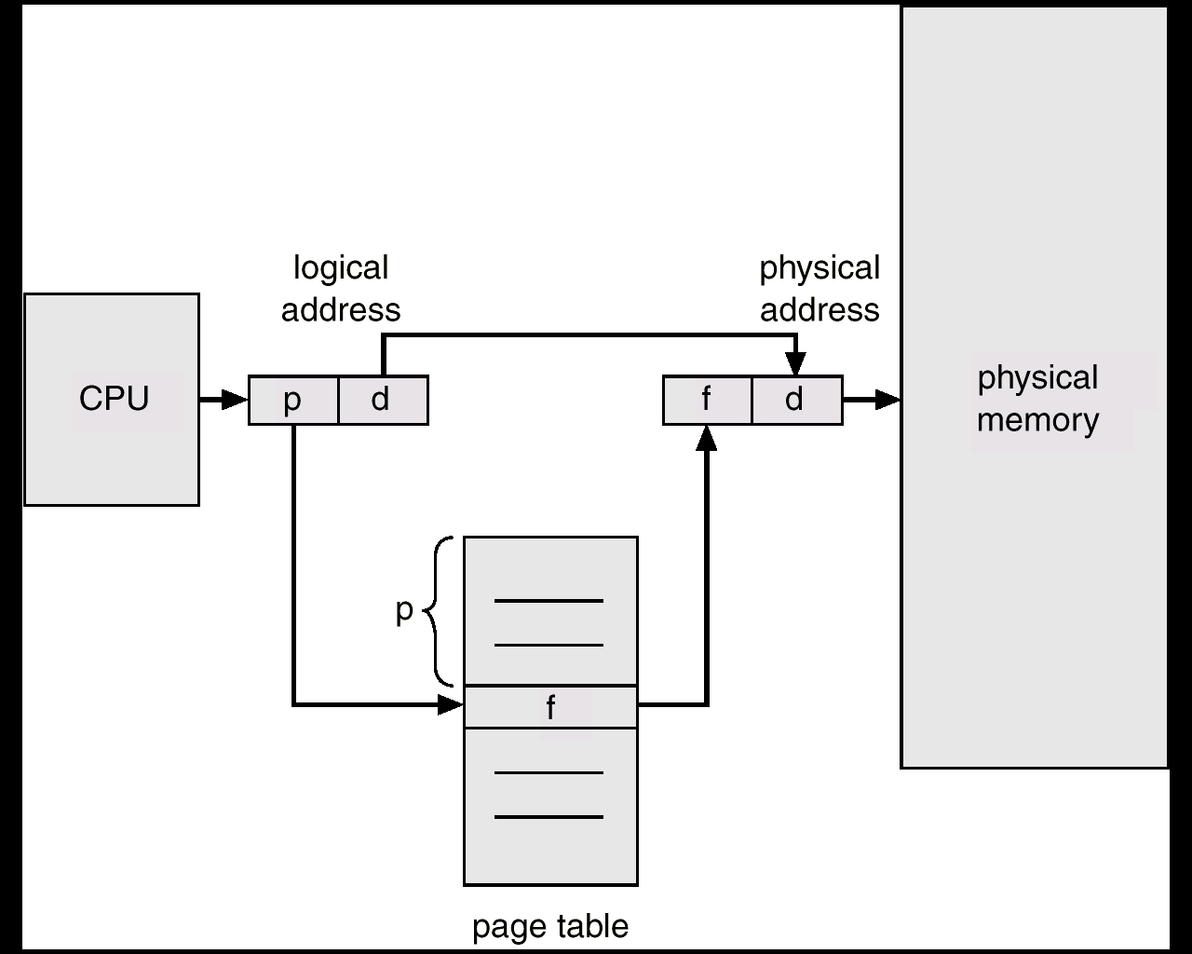
Address Translation Scheme (Cont.)
Page size: 2^{n} bytes
Logical address
space: 2^{m} bytes
Number of
pages: 2^{m-n}
n bits
p
d
m-n bits
Notes:
Logical address: m bits. There are 2^m bytes in logical address space.
Page size: 2^n. There are 2^m/2^n pages in logical address space.
(For the convenience of addressing, page size is always power of 2.)
Logical address is divided into two parts: lower n bits for page number and higher (m-n) bits for page number.
This figure suggests a hardware implementation. When a particular process is running, a register holds the starting address of the page table for that process. The page number of a virtual address is used to index that table and look up the corresponding frame number. This is combined with the offset portion of the virtual address to produce the desired real address. Typically, the page number field is longer than the frame number field.

Slide 28
Address Translation Scheme (Cont.)
Page Size (and Frame Size): 4 bytes
0
0
1
page #
frame #
1
2
2
Size of
Physical
memory:
8x4 = 32 bytes
8 Frames
3
3
4
0
1
1
1
5
Logical address space:
4x4 = 16 bytes
4 Pages
6
1
1
0
1
1
7
Notes:
Example: LOAD 0111 (7)
load “h” from logical address 0111
“h” is stored in physical location 11011 (27)
Translate “0111” to “11011”
To do address translation, need to know the logical address is in which page and the offset within the page

Slide 29
Implementation of Page Table
Page table is kept in physical memory.
Page-table base register (PTBR) points to the page table (for each process).
Page-table length register (PTLR) indicates size of the page table.
In this scheme every data/instruction access requires two memory accesses: one for the page table and one for the data/instruction.
Effective memory access time = 2 μ (assuming that memory cycle time is μ time unit)
Memory access time can be reduced by the use of a special fast-lookup hardware cache called associative registers or translation look-aside buffers (TLBs)
Notes:
PAGE TABLE STRUCTURE The basic mechanism for reading a word from memory involves the translation of a virtual, or logical, address, consisting of page number and offset, into a physical address, consisting of frame number and offset, using a page table. Because the page table is of variable length, depending on the size of the process, we cannot expect to hold it in registers. Instead, it must be in physical memory to be accessed.
With paging, the logical-to-physical address translation is still done with hardware support. Now the CPU must know how to access the page table of the current process -> page-table base register and page-table length register.
In principle, every virtual memory reference can cause two physical memory accesses: one to fetch the appropriate page table entry and one to fetch the desired data. Thus, a straightforward virtual memory scheme would have the effect of doubling the memory access time. To overcome this problem, most virtual memory schemes make use of a special high-speed cache for page table entries, usually called a translation lookaside buffer (TLB) .

Slide 30

Paging Using TLBs
Notes:
Essentially, TLB are associate registers which support parallel search.
Typically, there are 64 to 1024 entries in TLB.

Slide 31
Effective Access Time
TLBs Lookup = ε time unit
Assume memory cycle time is μ time unit
Hit ratio – percentage of times that a page number is found in the associative registers.
Hit ratio = α
Effective Access Time (EAT)
EAT = (μ + ε) α + (2 μ + ε)(1 – α)
= (2- α) μ + ε

Slide 32
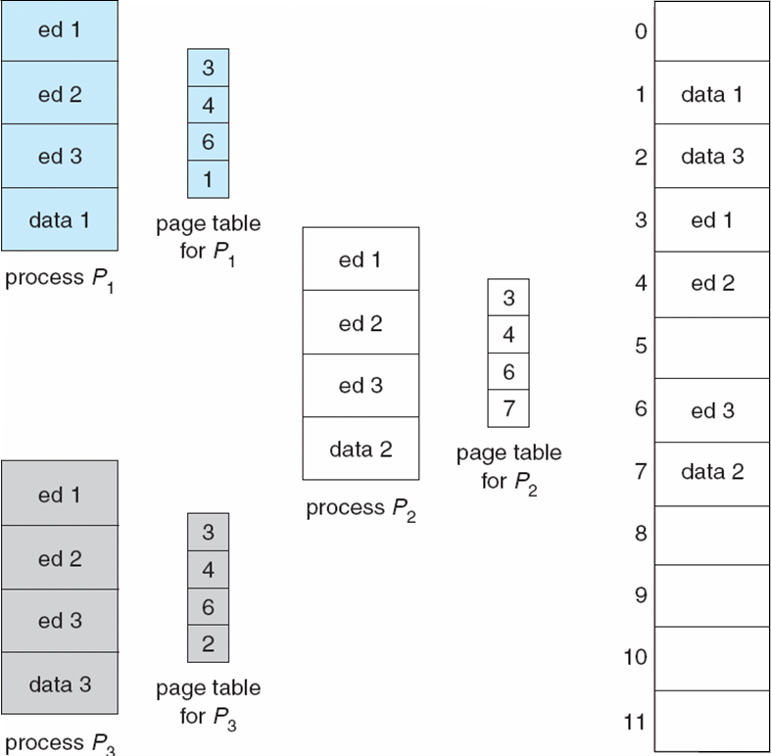
Shared Pages
Logical space
physical memory
Notes:
Sharing pages will reduce the memory usage.
In this example, three processes execute the same editor but on different data. Each process has its own logical address space, but they contain the same editor code (i.e., pages ed1, ed2, and ed3). So, instead of loading three copies of the editor code, only one copy needs to be loaded in the memory and this copy can be shared amongst 3 processes (by mapping ed1, ed2, and ed3 in each process’s logical address space to the corresponding editor pages loaded in the memory as shown in the slide). This is only possible if code is read-only code (re-entrant code).
Shared code
One copy of read-only (reentrant) code shared among processes (i.e., text editors, compilers, window systems).
Shared code must appear in same location in the logical address space of all processes
Private code and data
Each process keeps a separate copy of the private code and data
The pages for the private code and data can appear anywhere in the logical address space

Slide 33
Two-Level Page-Table Scheme
A logical address (on 32-bit machine with 4K page size)
A logical address is divided into:
a page number consisting of 20 bits.
a page offset consisting of 12 bits.
2²⁰ entries in a page table
If each entry consists of 4 bytes, each page table occupies 4 megabyte of memory!
A large page table is divided up to be easier to allocate in physical memory, with a small increase in effective access time
page number
page offset
p
d
20
12

Slide 34
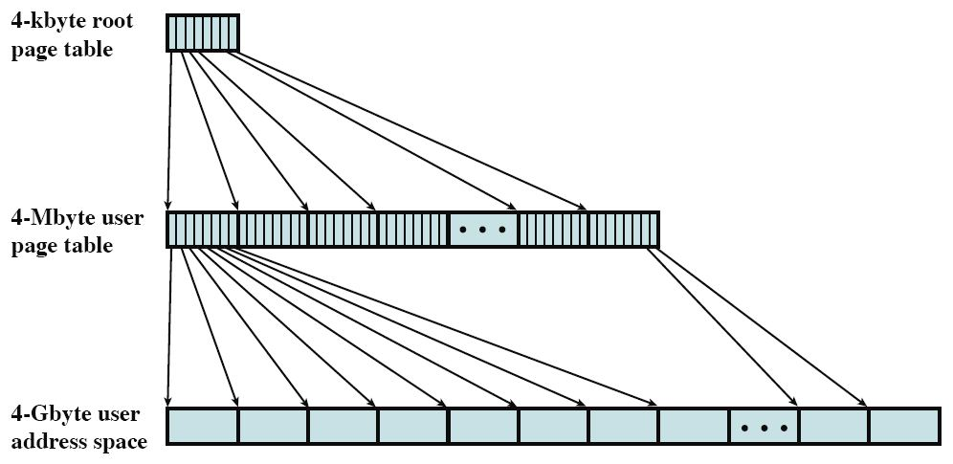
Two-Level Page-Table Scheme (Cont.)
4-Kbye outer
Number of Entries: 2¹⁰
(4 x 2¹⁰ Bytes)
Number of Entries
Per Page: 2¹⁰
Number of Entries: 2²⁰
Number of Pages: 2¹⁰
(4 x 2²⁰ Bytes)
Entry Size: 4 Bytes
(2³² Bytes)
Number of Pages: 2²⁰
Page Size: 4 x 2¹⁰ Bytes
Notes:
This figure shows an example of a two-level scheme typical for use with a 32-bit address.
If we assume byte-level addressing and 4-kbyte (2^12 ) pages, then the 4-Gbyte (2^32 ) virtual address space is composed of 2^20 pages.
If each of these pages is mapped by a 4-byte page table entry, we can create a user page table composed of 2^20 entries, requiring 4 Mbytes (2^22 ).
This huge user page table, occupying 2^10 pages, can be kept in virtual memory and mapped by an outer page table with 2^10 entries, occupying 4 Kbyte (2^12 ) of physical memory.

Slide 35
Two-Level Page-Table Scheme (Cont.)
Since the page table is paged, the page number is further divided into:
p₁: an index into the outer page (second level) table
The outer page table contains (4 x 2²⁰) / 4K = 2¹⁰ number of entries -> 10 bits for p₁
p₂: is an index into a page of the inner (first level) page table
Each page in the page table contains(4 x 2¹⁰) / 4 = 2¹⁰ number of entries -> 10 bits for p₂
Thus, a logical address is as follows:
page number
page offset
p₁
p₂
d
10
10
12

Slide 36

Two-Level Page-Table Scheme (Cont.)
Address-translation scheme for a two-level 32-bit paging architecture
PTBR
physical address
F#2
F#2
d
F#1
F#2
physical
memory
Notes:
This figure shows the steps involved in address translation for this scheme. The outer page table always remains in physical memory. The first 10 bits of a virtual address are used to index into the outer page table to find an entry for a page of the page table. If that page is not in physical memory, a page fault occurs. If that page is in physical memory, then the next 10 bits of the virtual address index into the page table to find the entry for the page that is referenced by the virtual address.
Multiple-level paging is used in many systems, e.g., Intel IA-32 (Pentium) and IA-64 (Itanium).

Slide 37
Inverted Page Table
Usually each process has its own page table. Hence the system could have many page tables, consuming substantial memory space
The page table size is proportional to that of the logical address space.
Alternative: have a single table with one entry for each physical frame, as <process-id, page-no>. This is called an Inverted Page Table
Logical address: <process-id, page-no, offset>
Increases search time: table sorted by physical address but lookups occur on logical address
Notes:
A drawback of the type of page tables that we have been discussing is that their size is proportional to that of the logical address space and there is one page-table for each process.
An alternative approach is the use of an inverted page table structure.
Entries in the inverted page table are ordered by the frame number order. Each entry contains <pid, page number> tuple. pid is needed because the inverted page table is shared by all the processes – the OS needs to know the page mapped to the frame belongs to which process.

Slide 38

Inverted Page Table (Cont.)
To access memory, the pair <process-id, page-no> is presented to inverted page table to find a match.
If match is found, say at entry i, then physical addr <i, offset> is obtained.
Notes:
Process id is added to logical address. Given the pair <pid, p>, the inverted page table is searched to locate a matching entry. If entry i is a matching entry (that is, it contains <pid, p>), the page p of process pid is mapped to frame i.
There is overhead in locating an entry, since entries are arranged in the frame number order (rather in the page number order as in conventional page table).

Slide 39
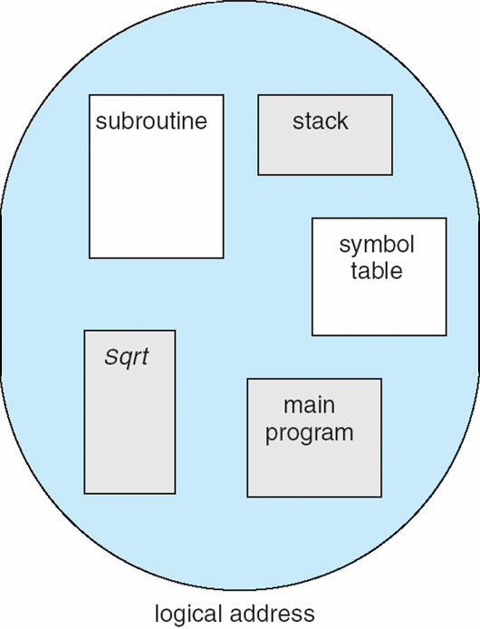
Segmentation
A memory-management scheme that break program up into its logical segments and allocating space for these segments into memory separately.
Unlike pages, segments can be of variable size
A process has a collection of segments.
Like pages of a process, segments of a process may not be allocated contiguously
logical address space
Notes:
Logical address space is viewed as a collection of segments. A segment is a logical unit such as:
main program,
function,
local variables, global variables,
stack,
symbol table, arrays

Slide 40
Segmentation (Cont.)
1
1
4
2
3
4
2
3
user space
physical memory space
logical address space
Notes:
This slide shows logical address space of a process with 4 segments. The 4 segments are loaded to different places in the physical memory.
Segmentation has a number of advantages to the paging scheme:
It simplifies the handling of growing data structures.
With segmented virtual memory, the dynamic data structure (e.g., heap) can be assigned its own segment, and the operating system will expand or shrink the segment as needed.
If a segment that needs to be expanded is in physical memory and there is insufficient room, the operating system may move the segment to a larger area of physical memory, if available, or swap it out. The enlarged segment would be swapped back in at the next opportunity.
[2. It allows programs to be altered and recompiled independently,
without requiring the entire program to be relinked and reloaded.]
3. It lends itself to sharing among processes.
Shared code/data can be put in a segment.
[4. It lends itself to protection.
Access right can be easily defined for each segment.]

Slide 41
Address Translation
Each segment has a segment no. & offset, i.e., its logical address is:
<segment-no, offset>,
Segment table. Each table entry has:
base – contains the starting physical address where the segments reside in memory.
limit – specifies the length of the segment.
Segment-table base register (STBR) points to the segment table’s location in memory
Segment-table length register (STLR) indicates number of segments used by a program;

Slide 42
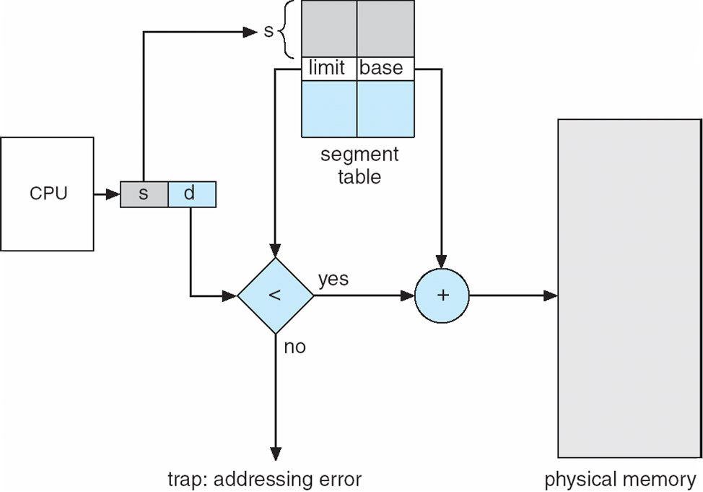
Address Translation (Cont.)
Lookup segment table
-> entry s
(2) Check if d<limit
(3) address=base+d

Slide 43
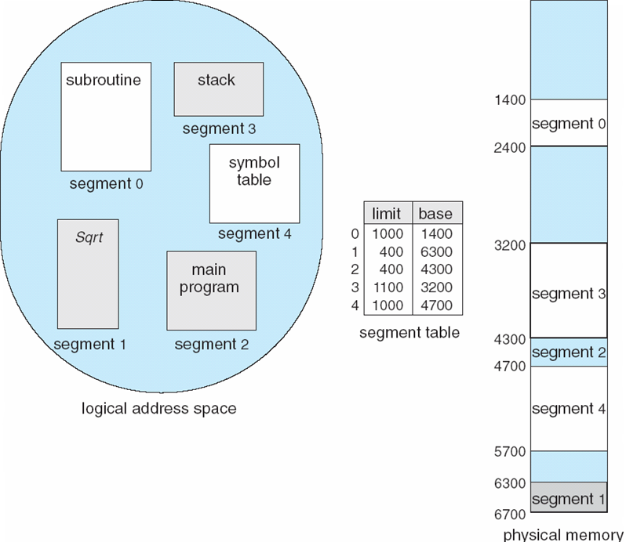
Address Translation (Cont.)
128
Q: translate <3, 128>
Ans: (1) lookup segment table → base=3200, limit=1100
(2) 128<1100, true.
(3) address=3200+128 =3328.

Slide 44
Fragmentation in Segmentation
Since segments vary in length, memory allocation is a dynamic storage-allocation problem. Usually use best-fit or first-fit.
Suffer from external fragmentation as process leaves the system, its occupied segments become holes in the memory.
As a process leaves the system, its occupied segments become holes of varying sizes in the memory.
Notes:
Memory allocation of a segmentation is similar to dynamic partitioning. Various dynamic storage allocation strategies (e.g., first-fit, best-fit, and worst-fit) can be used. The difference, compared to dynamic partitioning, is that a process image may occupy more than one partition, and these partitions need not be contiguous. Segmentation eliminates internal fragmentation but, like dynamic partitioning, it suffers from external fragmentation. However, because a process is broken up into a number of smaller pieces (segments), the external fragmentation should be less.

Slide 45
Summary
Programs must be brought into memory for execution ⇒ Memory Allocation
Contiguous Allocation
fix partition vs. dynamic partition
Non-contiguous Allocation
paging
Fragmentation Problem

Slide 46
Summary
Process executes in its logical address space, but the actual code and data are stored in physical memory ⇒ Mapping of logical address to physical address
Contiguous Allocation
relocation register
Paging
basic scheme
using translation look-aside buffer
multilevel paging
Inverted page table

Slide 47
Summary
Address-translation scheme for contiguous memory allocation
1024
800
1824

Slide 48
Summary
Address-translation scheme for paging
Page size: 2^{n}
Logical address
space: 2^{m}
Number of
pages: 2^{m-n}
n bits
p
d
m-n bits
Notes:
This figure suggests a hardware implementation. When a particular process is running, a register holds the starting address of the page table for that
process. The page number of a virtual address is used to index that table and look up the corresponding frame number. This is combined with the offset portion of the virtual address to produce the desired real address. Typically, the page number field is longer than the frame number field.

Slide 49
Summary
Address-translation scheme for a two-level 32-bit paging architecture
PTBR
physical address
F#2
F#2
d
F#1
F#2
physical
memory
Notes:
This figure shows the steps involved in address translation for this scheme. The outer page table always remains in main memory. The first 10 bits of a virtual address are used to index into the outer page table to find an entry for a page of the page table. If that page is not in main memory, a page fault
occurs. If that page is in main memory, then the next 10 bits of the virtual address index into the page table to find the entry for the page that is referenced by the virtual address.

Slide 50
Summary
Address translation scheme for inverted page table.
Notes:
Process id is added to logical address. Given the pair <pid, p>, the inverted page table is searched to locate a matching entry. If entry i is a matching entry (that is, it contains <pid, p>), the page p of process pid is mapped to frame i.
There is overhead in locating an entry, since entries are arranged in the frame number order (rather in the page number order as in conventional page table).

Slide 51
Summary
Address translation scheme for segmentation.
128
Q: translate <3, 128>
Ans: (1) lookup segment table → base=3200, limit=1100
(2) 128<1100, true.
(3) address=3200+128 =3328.

